Slide 1
Lecture 1: Data Warehousing, Business Intelligence, and Dimensional Modeling Primer
Chapter 1

Slide 2
What is a Data Warehouse?
“A data warehouse is a type of data management system that is designed to enable and support business intelligence (BI) activities, especially analytics.”
Solely intended to perform queries and analysis;
Often contain large amounts of historical data;
Organization’s “single source of truth.”
“The data within a data warehouse is usually derived from a wide range of sources such as application log files and transaction applications.”

Slide 3
Elements in a Typical Data Warehouse
A relational database to store and manage data;
An extraction, loading, and transformation (ELT) solution for preparing the data for preparing the data for analysis;
Statistical analysis, reporting, and data mining capabilities;
Client analysis tools for visualizing and presenting data to business users;
More sophisticated analytical applications that generate actionable information by applying machine learning and artificial intelligence (AI) algorithms;

Slide 4
Differences between Database and Data Warehouse
Database
is a collection of related data that represents the real world;
is designed to record data;
Application-oriented-collection of data;
Uses Online Transactional Processing (OLTP);
Tables and joins are complicated (Normalized);
ER modeling techniques;
Data Warehouse
is an information system that stores historical and commutative data from single or multiple sources;
is designed to analyze data;
Subject-oriented collection of data;
Uses Online Analytical Processing (OLAP);
tables and joins are easy (Denormalized);
Data modeling techniques;

Slide 5
Data Warehouse—Subject-Oriented
Organized around major subjects, such as customer, product, sales.
Focusing on the modeling and analysis of data for decision makers, not on daily operations or transaction processing.
Provide a simple and concise view around particular subject issues by excluding data that are not useful in the decision support process.

Slide 6
Data Warehouse—Integrated
Constructed by integrating multiple, heterogeneous data sources
relational databases, flat files, on-line transaction records
Data cleaning and data integration techniques are applied.
Ensure consistency in naming conventions, encoding structures, attribute measures, etc. among different data sources
E.g., Hotel price: currency, tax, breakfast covered, etc.
When data is moved to the warehouse, it is converted

Slide 7
Data Warehouse—Time Variant
The time horizon for the data warehouse is significantly longer than that of operational systems.
Operational database: current value data.
Data warehouse data: provide information from a historical perspective (e.g., past 5-10 years)
Every key structure in the data warehouse
Contains an element of time, explicitly or implicitly
But the key of operational data may or may not contain “time element”.

Slide 8
Data Warehouse—Non-Volatile
A physically separate store of data transformed from the operational environment.
Operational update of data does not occur in the data warehouse environment.
Does not require transaction processing, recovery, and concurrency control mechanisms
Requires only two operations in data accessing:
initial loading of data and access of data.

Slide 9
OLTP (Relational DBMS) V.S. OLAP (Data Warehouse)
OLTP (on-line transaction processing)
Major task of traditional relational DBMS
Day-to-day operations: purchasing, inventory, banking, manufacturing, payroll, registration, accounting, etc.
OLAP (on-line analytical processing)
Major task of data warehouse system
Data analysis and decision making

Slide 10
OLTP (Relational DBMS) V.S. OLAP (Data Warehouse)

Slide 11
Why Separate Data Warehouse?
High performance for both systems
DBMS— tuned for OLTP: access methods, indexing, concurrency control, recovery
Warehouse—tuned for OLAP: complex OLAP queries, multidimensional view, consolidation.
Different functions and different data:
missing data: Decision support requires historical data which operational DBs do not typically maintain
data consolidation: DS requires consolidation (aggregation, summarization) of data from heterogeneous sources
data quality: different sources typically use inconsistent data representations, codes and formats which have to be reconciled

Slide 12
Goal of Data Warehousing and Business Intelligence
Make information easily accessible;
Present information consistently;
Adapt to change;
Present information in a timely way;
Be a secure bastion that protects the information assets;
Serve as the authoritative and trustworthy foundation for improved decision making;
The business community must accept the DW/BI system to deem it successful.

Slide 13
Responsibilities of DW/BI Managers
Understand the business users;
Deliver high-quality, relevant, and accessible information and analytics to the business users;
Sustain the DW/BI environment;

Slide 14
Introduction to Dimensional Modeling
A data warehouse is based on a multidimensional data model.
Dimensional modeling is a longstanding technique for making databases simple.
Deliver data that’s understandable to the business users.
Deliver fast query performance.
It contains the same information as a normalized model, but packages the data in a format that delivers user understandability, query performance, and resilience to change.

Slide 15
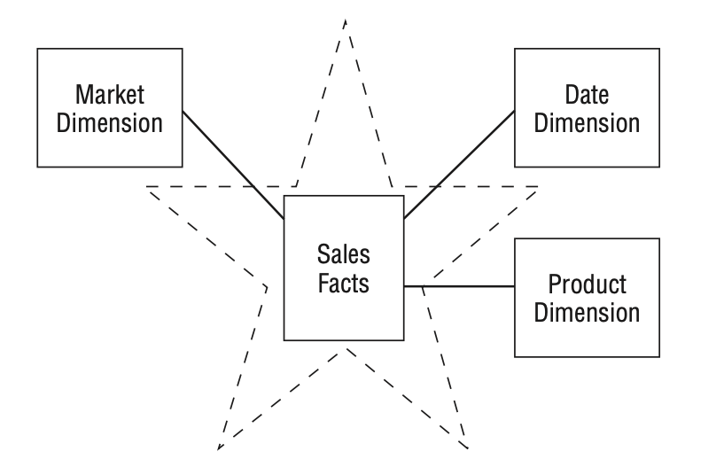
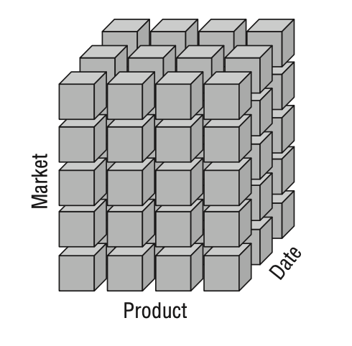
Introduction to Dimensional Modeling
Star schemas: Dimensional models implemented in relational database management systems
Online analytical processing (OLAP) cubes: Dimensional models implemented in multidimensional database environments

Slide 16
A Sample Data Cube
Date
1Qtr
2Qtr
3Qtr
4Qtr
sum
Product
TV
PC
U.S.A
VCR
sum
Canada
Country
Mexico
sum
All, All, All

Slide 17
Star Schemas Versus OLAP Cubes
Both stars and cubes have a common logical design with recognizable dimensions; however, the physical implementation differs.
OLAP cube:
Performance aggregations or precalculated summary tables are often created and managed;
Deliver superior query performance;
Provide more analytically robust functions;
Pay a load performance price;
Detailed, atomic information be loaded into a star schema; optional OLAP cubes are then populated from the star schema.

Slide 18
Intuitive to Business Users

Slide 19
Fact Tables for Measurements
Fact table: stores the performance measurements resulting from an organization’s business process events.
Fact: a business measure;
Each row in a fact table: a measurement event. The data on each row is at a specific level of detail, referred to as the grain, such as one row per product sold on a sales transaction;
All the measurement rows in a fact table must be at the same grain.

Slide 20
Fact Table cont.
Deep in terms of the number of rows, but narrow in terms of the number of columns.
Fact tables have two or more foreign keys (refer to the FK notation) that connect to the dimension tables’ primary keys.
Fact table has its own primary key composed of a subset of the foreign keys (composite key).
Every table that has a composite key is a fact table.
Fact tables express many-to-many relationships.

Slide 21
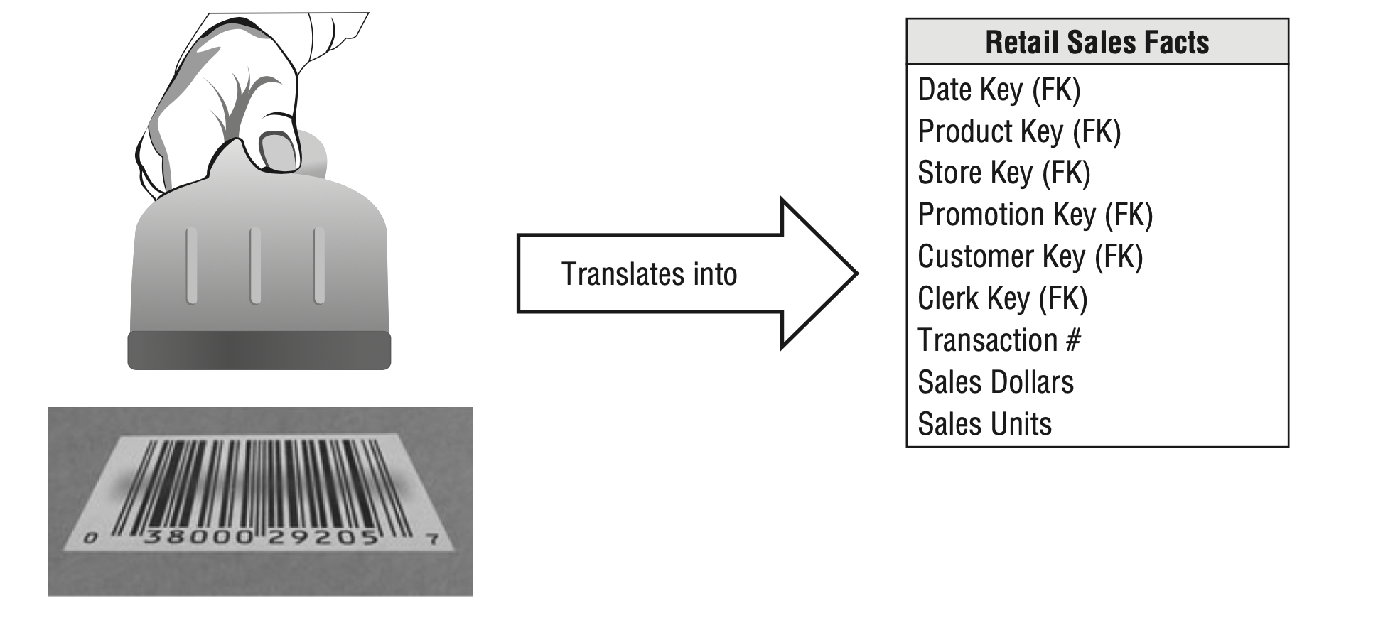
Business process measurement events translate into fact tables

Slide 22
Dimension Tables for Descriptive Context
Dimension tables are integral companions to a fact table.
Contain the textual context associated with a business process measurement event.
Have fewer rows than fact tables, but can be wide with many large text columns.
Each dimension is defined by a single primary key (refer to the PK notation), which serves as the basis for referential integrity with any given fact table to which it is joined.

Slide 23
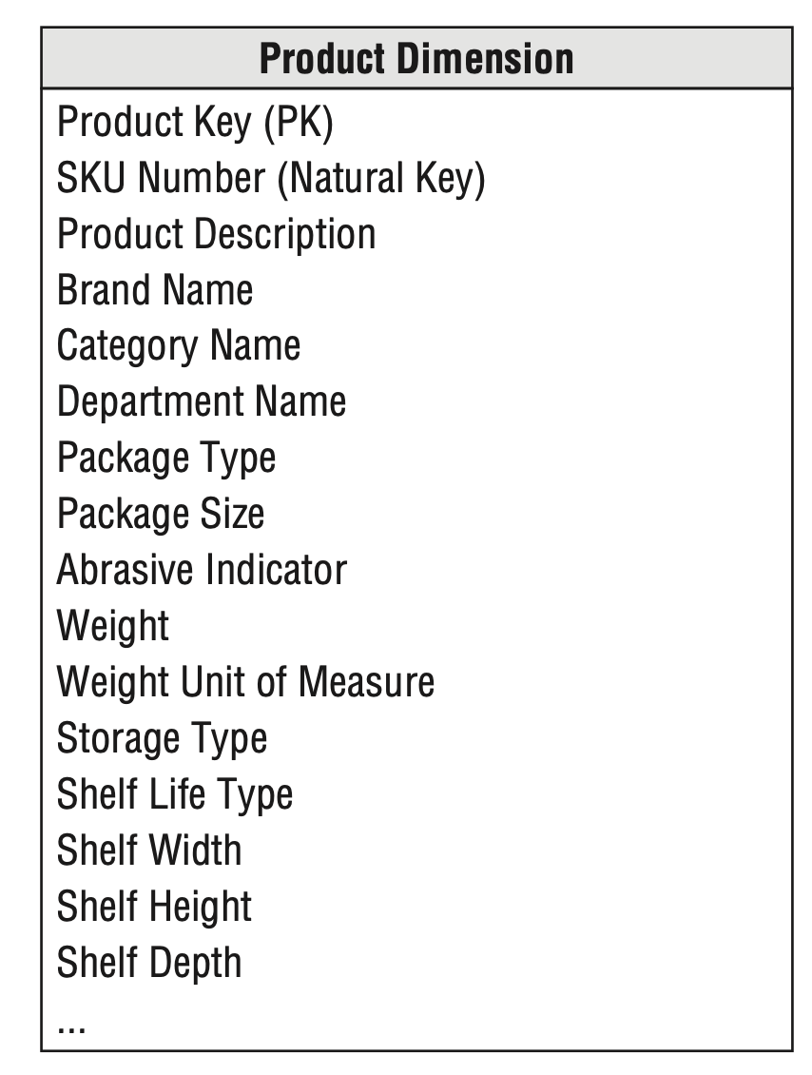
Dimension tables contain descriptive characteristics of business process nouns

Slide 24
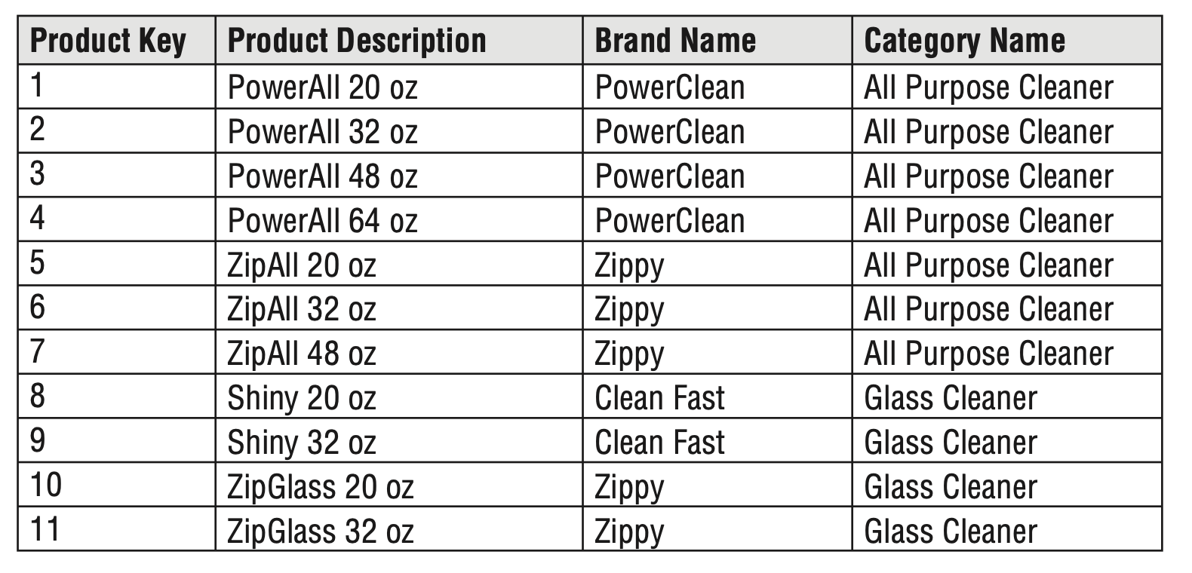
Dimension Tables cont.
Dimension tables often represent hierarchical relationships.
Dimension tables typically are highly denormalized with flattened many-to-one relationships within a single dimension table.

Slide 25
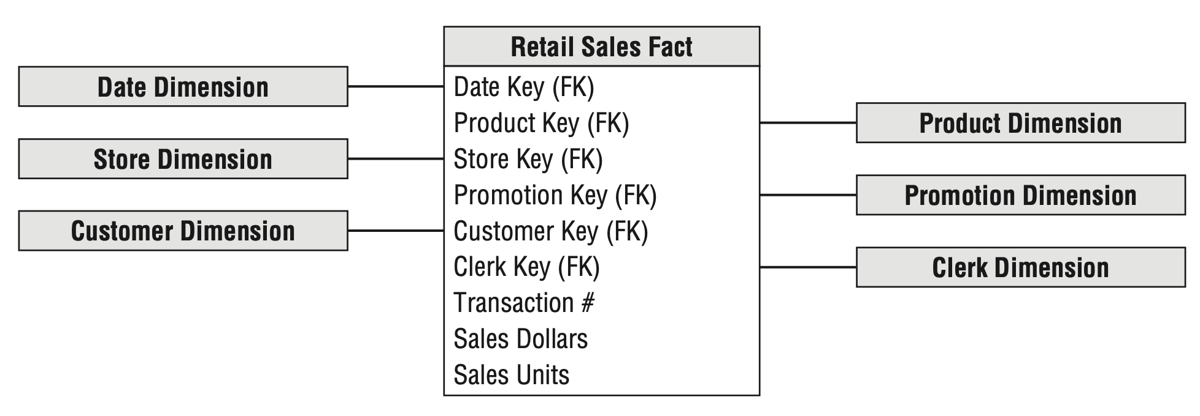
Facts and Dimensions Joined in a Star Schema
Each business process is represented by a dimensional model
a fact table containing the event’s numeric measurements
a halo of dimension tables that contain the textual context that was true at the moment the event occurred.

Slide 26
Benefit of dimensional schema
Simplicity: the data is easier to understand and navigate.
Symmetry: every dimension is equivalent; all dimensions are symmetrically equal entry points into the fact table.
Extensible to accommodate change: the predictable framework of a dimensional model withstands unexpected changes in user behavior.

Slide 27
Kimball’s DW/BI Architecture
Four separate and distinct components: operational source systems, ETL system, data presentation area, and business intelligence applications.
Operational Source Systems: capture the business’s transactions
Extract, Transformation, and Load System (ETL): consists of a work area, instantiated data structures, and a set of processes.
Presentation Area to Support Business Intelligence: where data is organized, stored, and made available for direct querying by users, report writers, and other analytical BI applications.
Business Intelligence Applications: the range of capabilities provided to business users to leverage the presentation area for analytic decision making.

Slide 28
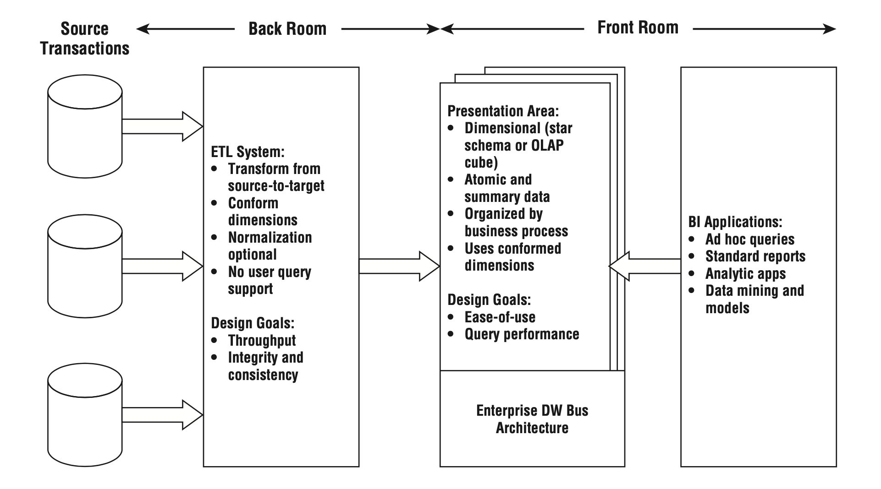
Kimball’s DW/BI Architecture

Slide 29
Operational Source Systems
The main priorities of the source systems are processing performance and availability.
Source systems maintain little historical data;
A good data warehouse can relieve the source systems of much of the responsibility for representing the past.

Slide 30
Extract, Transformation, and Load System (ETL)
Extraction: the process of getting data into the data warehouse environment (reading and understanding the source data and copying the data into the system).
Transformations, such as cleansing the data (correcting misspellings, resolving domain conflicts, dealing with missing elements, or parsing into standard formats), combining data from multiple sources, and de-duplicating data.
Load: the physical structuring and loading of data into the presentation area’s target dimensional models.

Slide 31
Presentation Area to Support Business Intelligence
The DW/BI presentation area is where data is organized, stored, and made available for direct querying by users, report writers, and other analytical BI applications.
The data be presented, stored, and accessed in dimensional schemas, either relational star schemas or OLAP cubes.
It must contain detailed, atomic data.
The most finely grained data must be available in the presentation area so that users can ask the most precise questions possible.
Should be structured around business process measurement events.

Slide 32
Business Intelligence Applications
All BI applications query the data in the DW/BI presentation area.
Using data for improved decision making.
A BI application can be as simple as an ad hoc query tool or as complex as a sophisticated data mining or modeling application.
Sophisticated applications, such as modeling or forecasting tools, may upload results back into the operational source systems, ETL system, or presentation area.

Slide 33
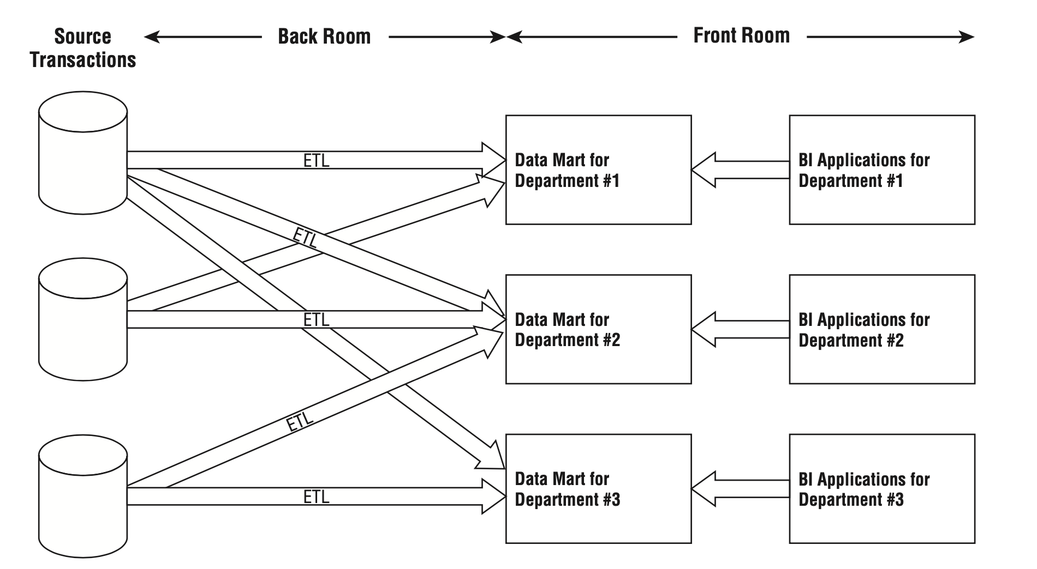
Alternative DW/BI Architectures
Independent Data Mart Architecture
Without any enterprise perspective;
Perpetuate incompatible views of the organization’s performance;
Unnecessary organizational debate and reconciliation.

Slide 34
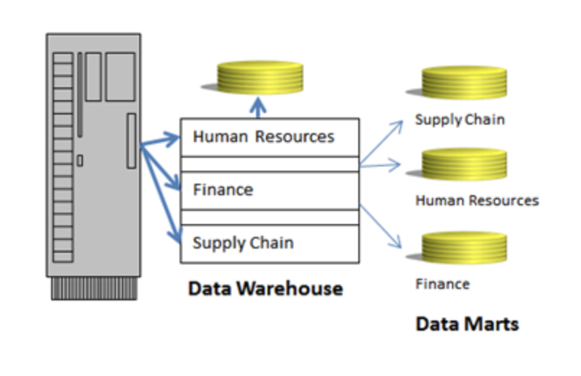
Data Warehouse V.S. Data Mart
A data mart is a simple section of the data warehouse that delivers a single functional data set.
In a human resources database, we could create data marts for Employees, Benefits, or Payroll.
Data warehouse is like the mega-mart. It houses ALL of the data.

Slide 35
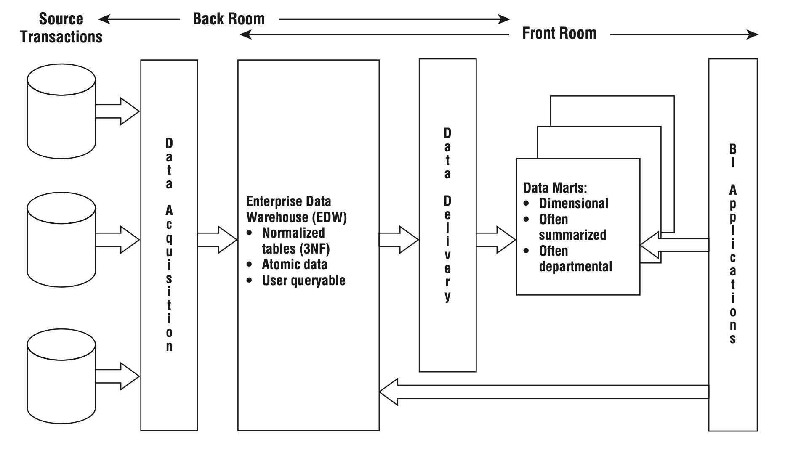
Alternative DW/BI Architectures
Hub-and-Spoke Corporate Information Factory (CIF) Inmon Architecture:
focusing on the core elements and concepts that warrant discussion;
The atomic data lands in a 3NF database; this normalized, atomic repository is referred to as the Enterprise Data Warehouse (EDW) within the CIF architecture.

